Slide 1
Introduction to using RStudio
Nathan Green, David Jorgensen

Slide 2

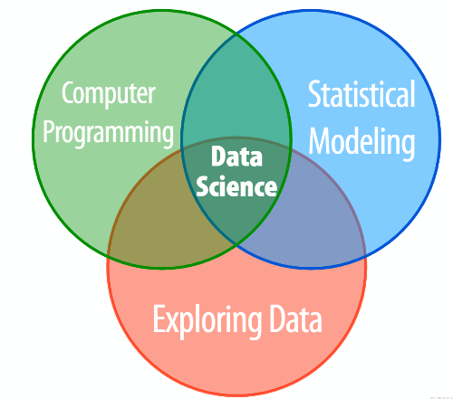

Slide 3
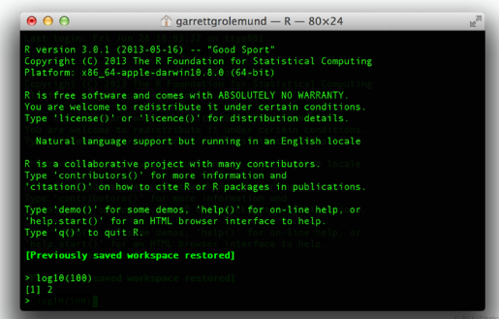
R can be run without Rstudio…but we don’t recommend it!

Slide 4
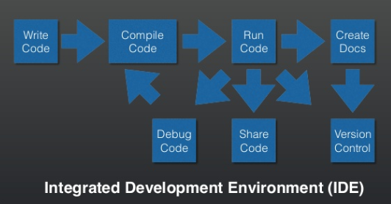
IDEs

Slide 5
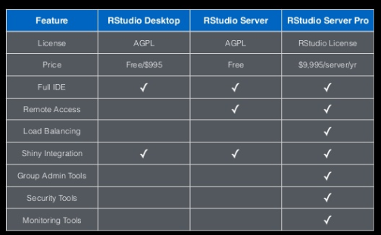
Version of RStudio

Slide 6
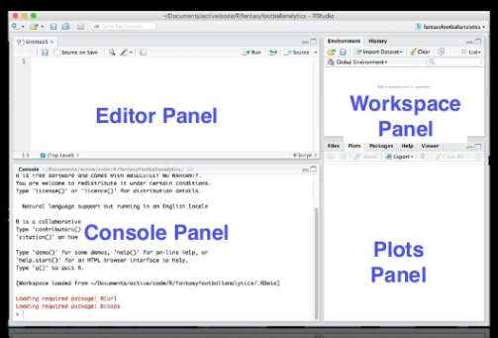
RStudio layout

Slide 7
Scripts
Editor Panel
Text file with R commands
.R extension

Slide 8
Console
Command prompt
Type commands here execute straight away
Starts with > sign (know at the prompt)
When you hit enter the output will be displayed below
As you enter commands you accumulate a history of past commands

Slide 9
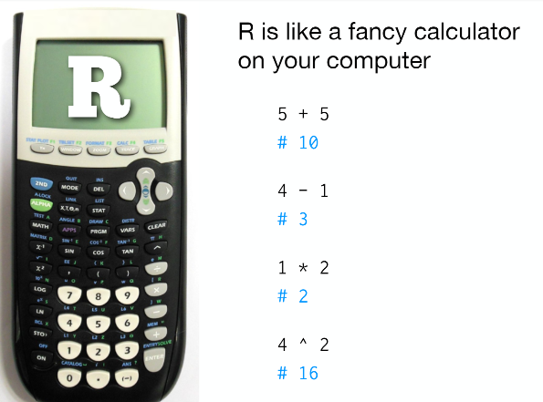

Slide 10
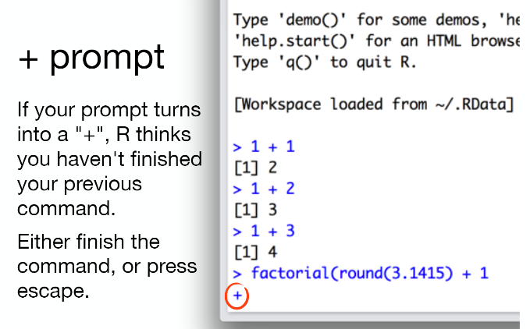

Slide 11
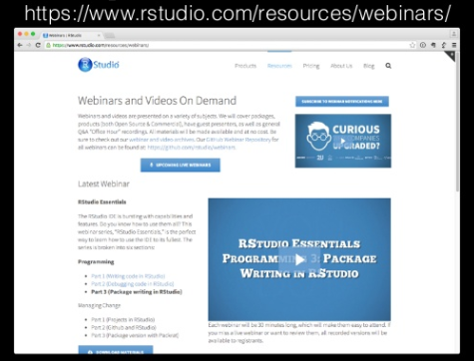
Help and Tutorials

Slide 12
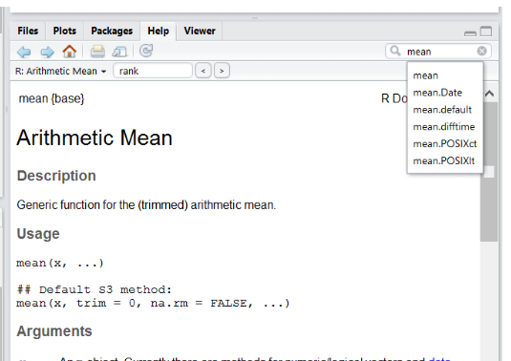
Getting help at the console
Several different ways to access help files
help(<name>)
?<name>
F1
Help tab search

Slide 13
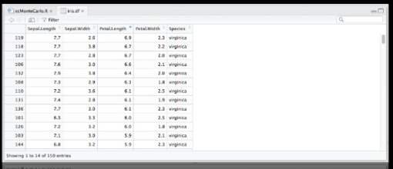
Viewer
Real time view of data
Filter, sort and search

Slide 14
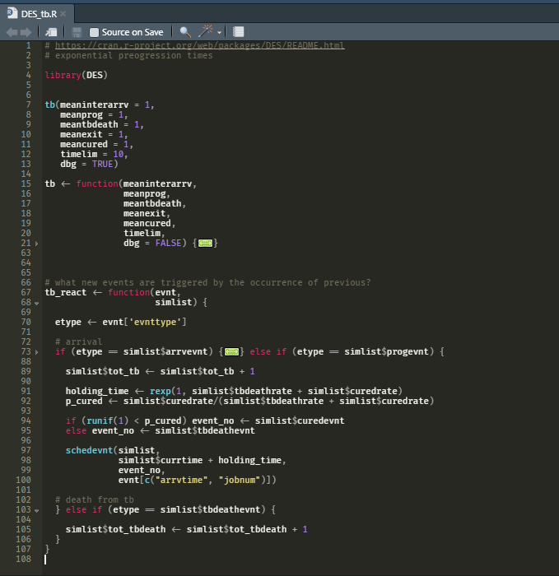
Syntax highlighting, navigation

Slide 15
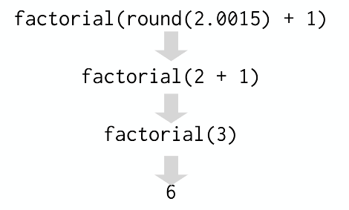
R always works from the innermost parenthesis to the outermost

Slide 16
Workflow

Slide 17
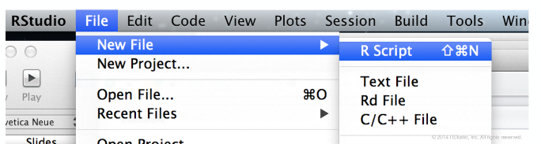
Its easier to compose your code in an R script than in the command line
To open a script, go to File>New File>R Script in the tool bar

Slide 18
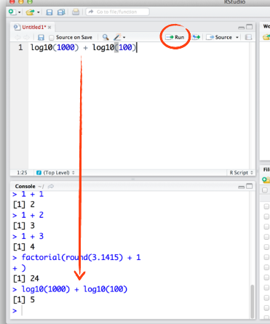
Common workflow
1. Write code in an R script
2. run code in console with Run

Slide 19
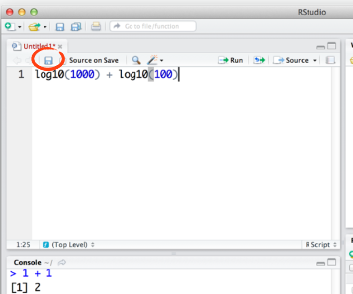
Save when finish
Either using icon or in dropdown menu

Slide 20
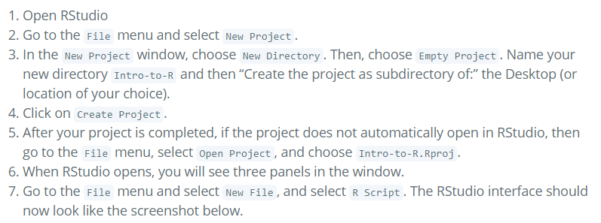
Creating a new project

Slide 21

The working directory
Where R currently thinks ‘home’ is, all file paths are relative to this
Visualise your working directory from the Files tab
If you want to choose different working directory you can navigate there using the More dropdown menu
See the File Pane

Slide 22
Workspace
ls()
See the Environment Pane

Slide 23
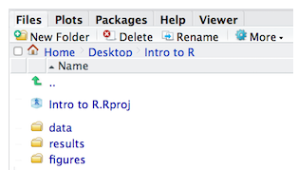
Structuring your working directory
You should separate data into original and intermediate
Eg you may want to create data/ directory to store raw data
And results/ directory to store analyses
Figure/ directory could be used for the plots you generate

Slide 24
Shortcuts
Up arrow
Tab
Ctrl + up arrow
Ctrl + enter
And many, many more…

Slide 25
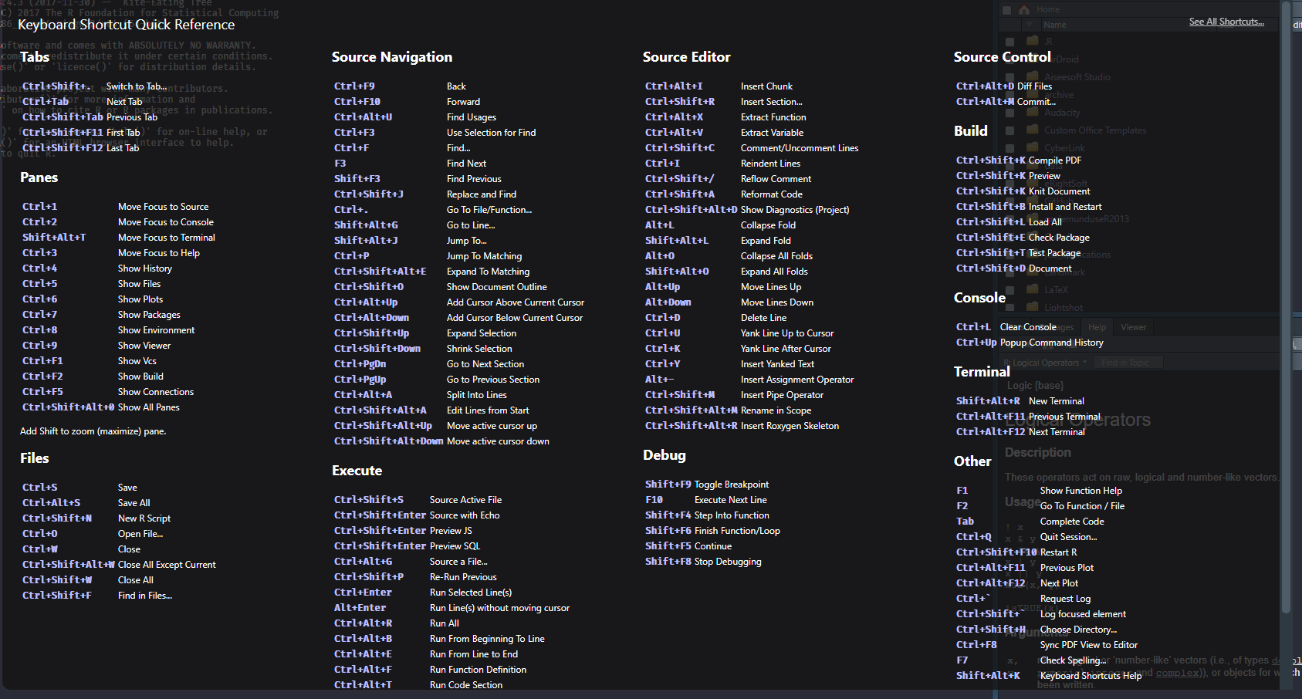
Keyboard shortcuts

